Slide 1
Spring Framework
Dang Thi Thao My

Slide 2
Content
Objectives
Overview
Spring MVC
Spring example

Slide 3
Objectives
At the end of this tutorial, you are able to:
Have a general understanding of Spring Framework
Create a simple Spring MVC web application
Configure .xml files of a Spring project
Map incoming request to a controller

Slide 4
Overview – Spring framework
An essential skeleton
Spring framework is modular. Pick modules applicable to your application.
Contribute POJOs (Plain Old Java Object) and configure to run within the framework
Better OOP (Object Oriented Programming)
Along with AOP (Aspect Oriented Programming)
Enforce good coding practices
Well-factored, reusable, readable, and manageable applications
Notes:
What makes a framework, work?
A framework is essentially a skeleton, a structure around which the fleshing out of your application occurs. Frameworks tend to be built around a design pattern and consist of frozen spots – structural components which are unmodified by the developer -- and hot spots, the pieces that an application developer contributes ^{[2]}. In Spring, the hot spots are developer-contributed POJOs which are configured to run within the framework.
In this chapter we'll explore the context of Spring's most important component – the IoC container – and how Spring can lead you to better Object Oriented programming and eventually to new possibilities with Aspect Oriented Programming. The Spring framework can't make bad code good, but it can enforce good coding practices that make it easier for you and your fellow developers to cooperate in writing well-factored, reusable, readable, and manageable application components.

Slide 5
Overview – Beans
POJOs – Beans instantiated, managed, created by Spring IoC
Beans are created with the configuration metadata (XML file) providing information for container on how to create bean, bean lifecycle, and bean dependencies.
Types of beans:
Singleton ( a single instance per Spring IoC container) – default
Prototype
Request
Session
Global-session

Slide 6
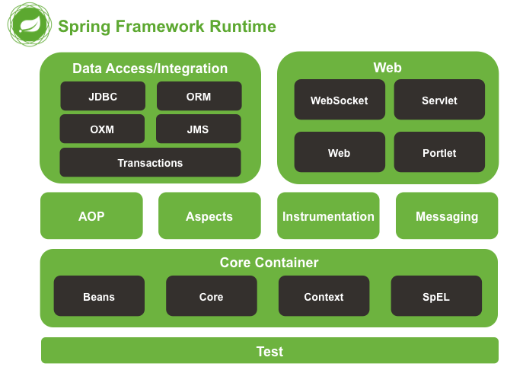
Overview - Modules
Core Container (IoC):
AOP (Aspect Oriented Programming):
DAO
ORM
JEE
Web
Notes:
The Core Module: Provides the Dependency Injection (DI) feature which is the basic concept of the Spring framework. This module contains the BeanFactory, an implementation of Factory Pattern which creates the bean as per the configurations provided by the developer in an XML file.
AOP Module: The Aspect Oriented Programming module allows developers to define method-interceptors and point cuts to keep the concerns apart. It is configured at run time so the compilation step is skipped. It aims at declarative transaction management which is easier to maintain.
DAO Module: This provides an abstraction layer to the low level task of creating a connection, releasing it etc. It also maintains a hierarchy of meaningful exceptions rather than throwing complicated error codes from specific database vendors. It uses AOP to manage transactions. Transactions can also be managed programmatically.
ORM Module: Spring doesn’t provides its own ORM implementation but offers integrations with popular Object Relational mapping tools like Hibernate, iBATIS SQL Maps, Oracle TopLink and JPA etc.
JEE Module: It also provides support for JMX, JCA, EJB and JMS etc. In lots of cases, JCA (Java EE Connection API) is much like JDBC, except where JDBC is focused on database JCA focus on connecting to legacy systems.
Web Module: Spring comes with MVC framework which eases the task of developing web applications. It also integrates well with the most popular MVC frameworks like Struts, Tapestry, JSF, Wicket etc.

Slide 7
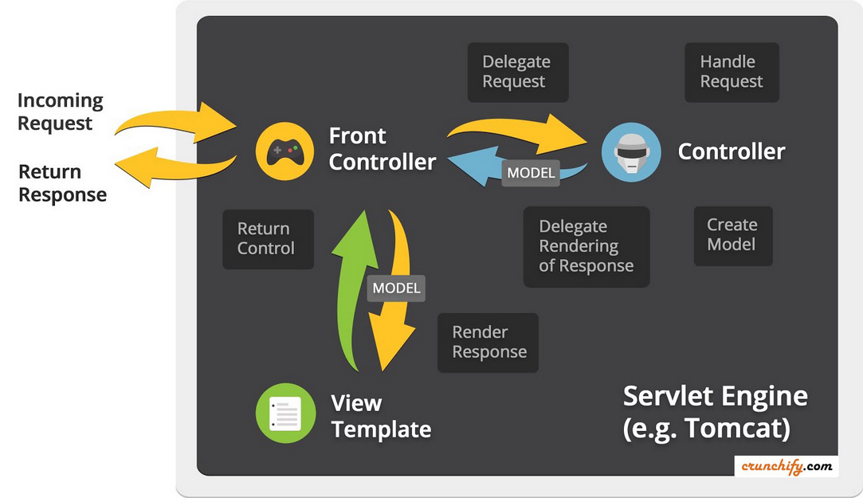
Concepts – DispatcherServlet

Slide 8
Dependency Injection - Polymorphism
Shape: Circle, Triangle
Draw()
Drawing Class
Protected class Drawing {
Private Shape shape;
Public setShape(Shape shape) {
This.shape = shape;
}
Public drawShape() {
This. Shape.draw()
}
}
Triable myTriangle = new Triangle();
Drawing.setShape(myTriable);
Drawing.drawShape();

